Slide 1
Factory Method

Slide 2
What is?
The main idea behind the Factory Method Pattern is to define an interface for creating objects, but defer the actual instantiation of those objects to subclasses.

Slide 3
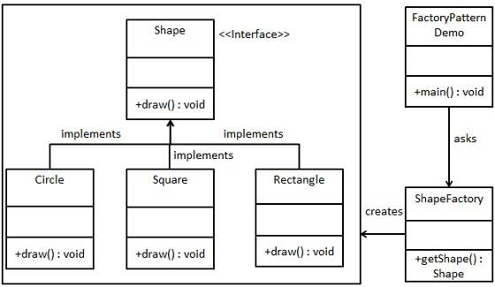
Implementation

